Slide 1

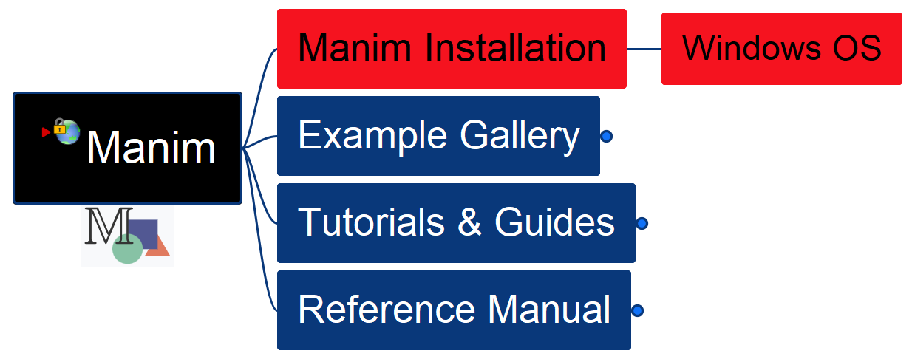

Learn Manim Library by Practice – Opening and Installation
001

Slide 2
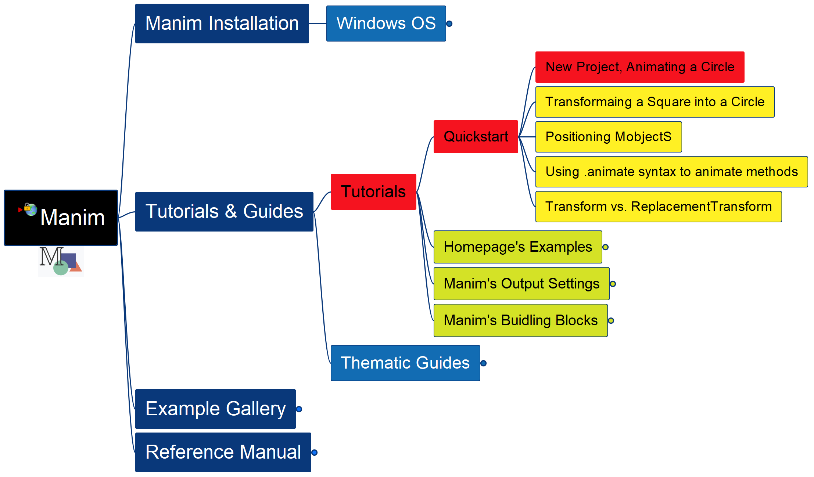
Learning Manim
002
Tutorial – QuickStart – New Project

